Slide 1
Capstone Project : Western Countries Financial Data
Present By : Mustafa Alam
Business Analyst / Data Analyst
alamcs86@gmail.com| +91 9608887454

Slide 2
Table of contents
Explored and summarized dataset using pivot table in Excel.
Cleaned data in power query excel and performed statistical analysis.
Imported data into MySQL Server created tables.
Verified data using multiple SQL queries.
Created charts and dashboard in Excel for initial insights.
Cleaned data, created measures, and visualized successfully.
Built an interactive dashboard to answer key business questions & used in dashboard KPI, Slicer filter, bar chart, column chart, line chart, world map, pie chart.
Derived insights for sales, profit, segments, and product performance

Slide 3
Details of Dataset – Western country financial sales data
Sales has been done across the countries – France, Germany, Mexico…
There is several product to be sale
The sale history is the year of 2013 and 2014
There was several segmental product to be sale for e.g – Government, enterprise e.t.c
In the dataset have multiple column for e.g – Gross sale of product , profit, sale, manufacturing price, COGS etc.

Slide 4
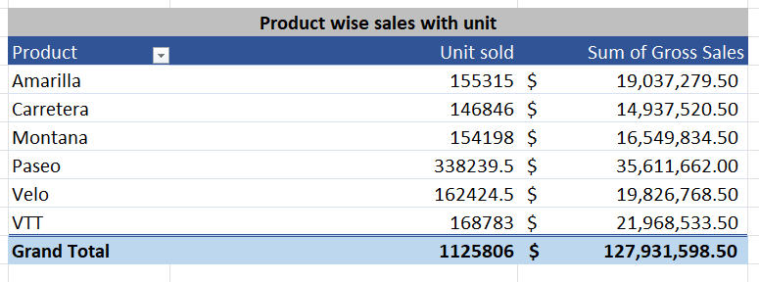
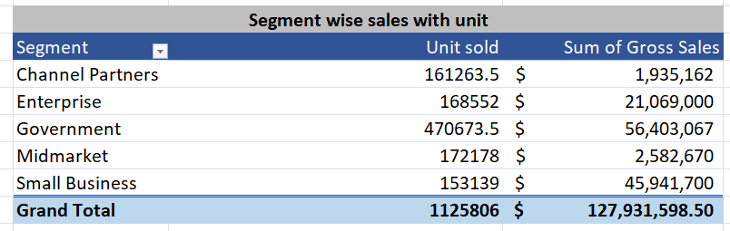
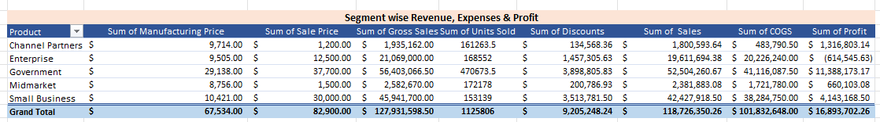
Summary - 01
Summary - 02
Summary - 03

Slide 5
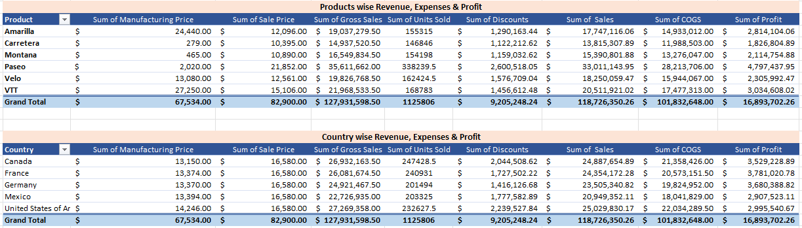
Summary - 04
Summary - 05

Slide 6
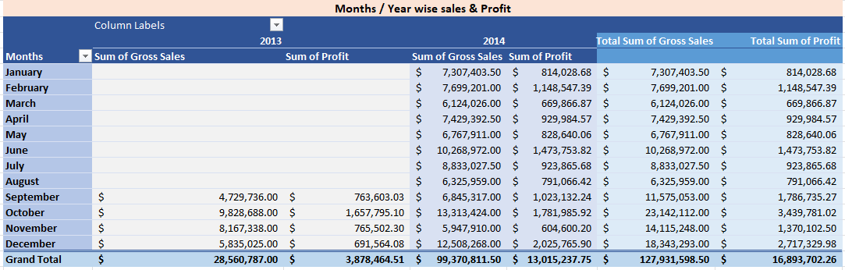
Summary – 06 (Months and year wise – sales & profit)

Slide 7
Data cleaning checked but 100% is correct, so cleaning not performed
Statistical Analysis performed in power query Transform > Statistics option of unit sold column
Mode has been calculated of unit sold column also.
Sum calculated also of Gross sale column
In the next page all statistical analysis available and summary table presented statical analysis

Slide 8
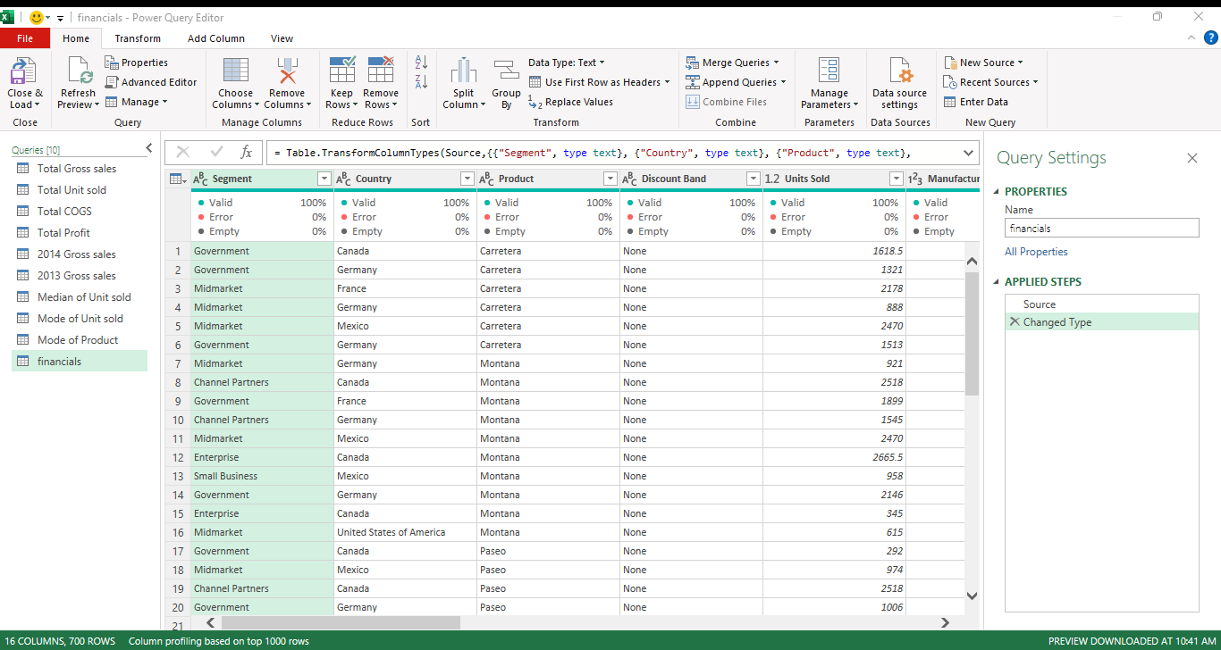
Data Cleaned 100%

Slide 9
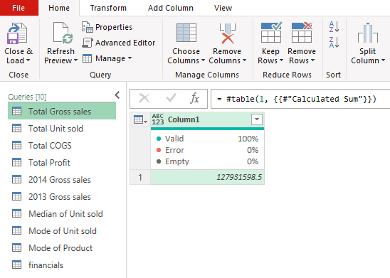
Transform -> statistics -> sum performed

Slide 10
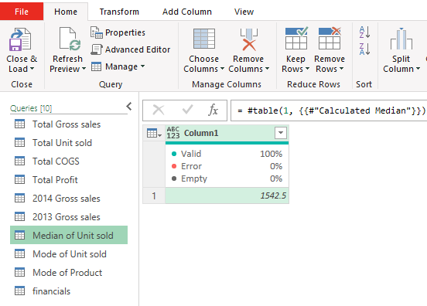
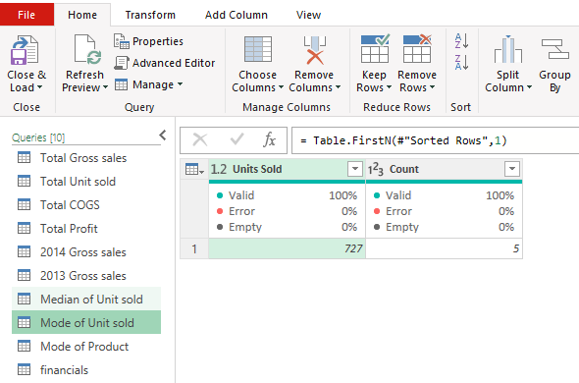
Median calculated of Unit sold
Mode calculated of Unit sold

Slide 11
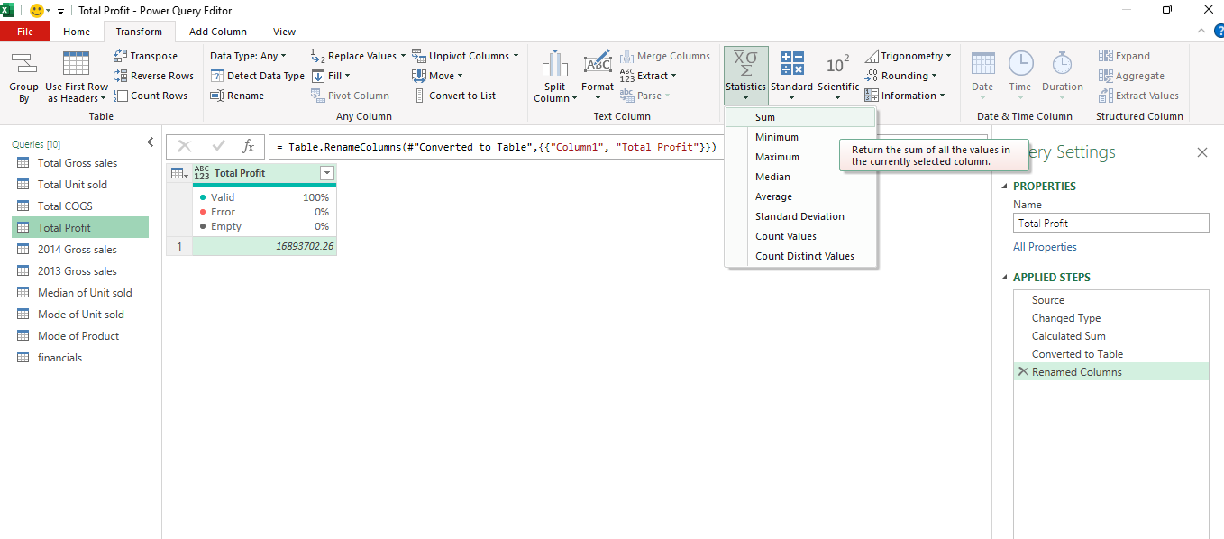

Slide 12
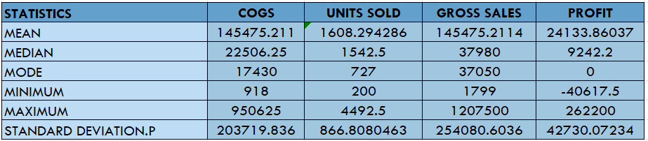
Statistical Analysis - COGS , UNITS SOLD, GROSS SALES AND PROFIT

Slide 13
DATA INSIGHT OF THE FOLLOWING INFORMATION
Total units sold (in percentage) by country represent information in bar chart
Compare sales and profit of product represent in column chart
Trend month wise sales and profit represent in line chart
Total units sold by product represent in pie chart by percentage
Count product year wise sold trend in line chart
Key metrics & KPI – Total gross sales / Proft / Unit sold / count of product
Filters used also for filtering – months/year, product , country, segment

Slide 14
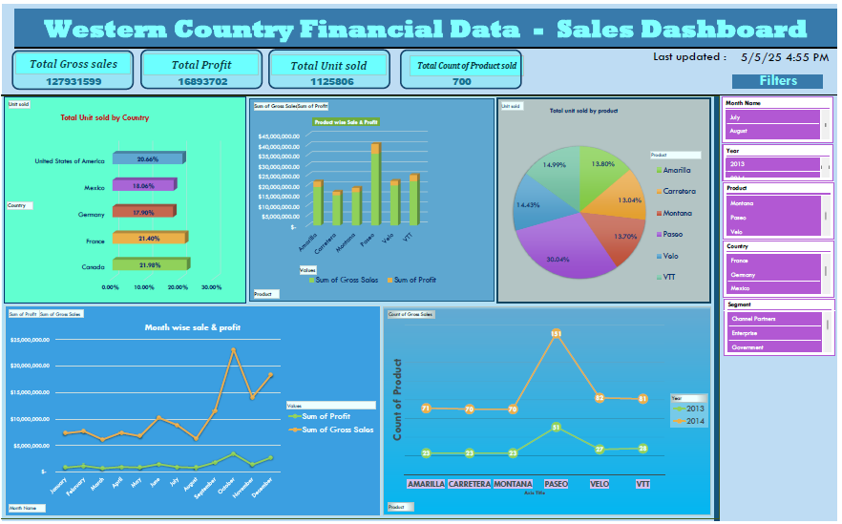

Slide 15
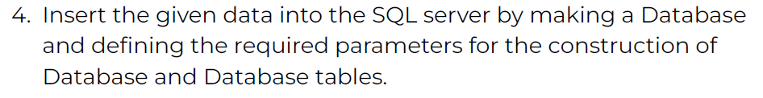
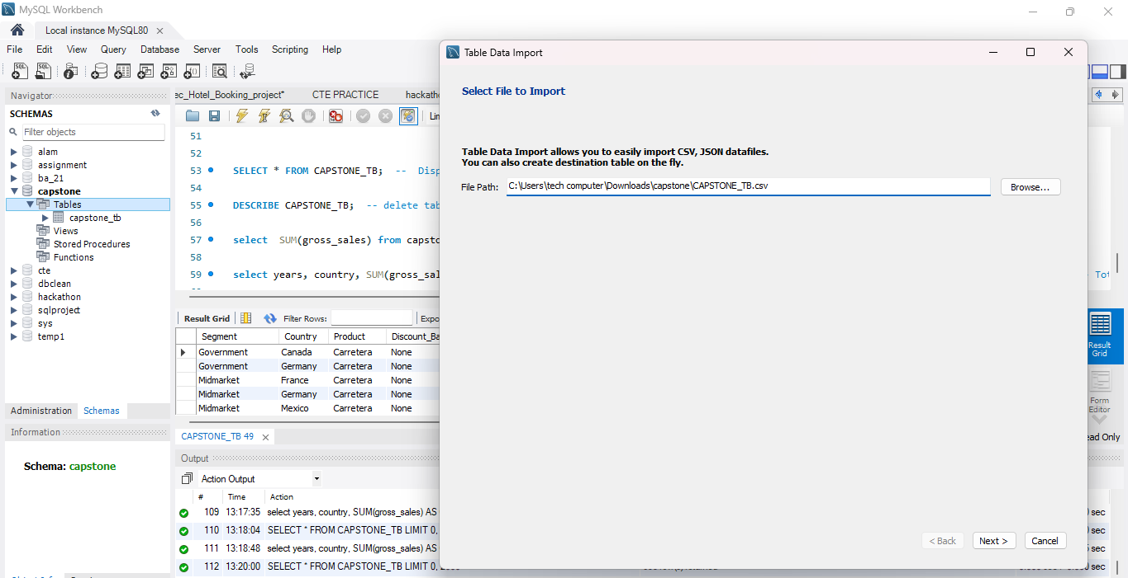
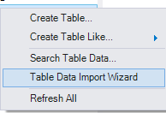

Slide 16

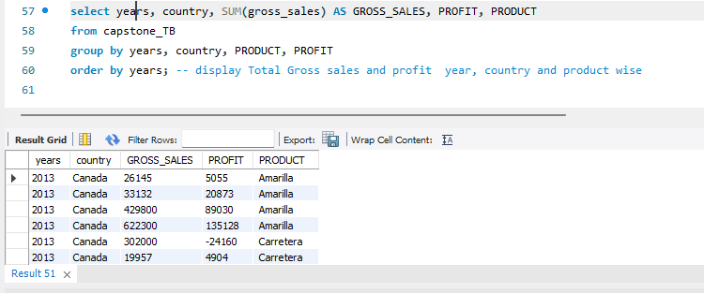
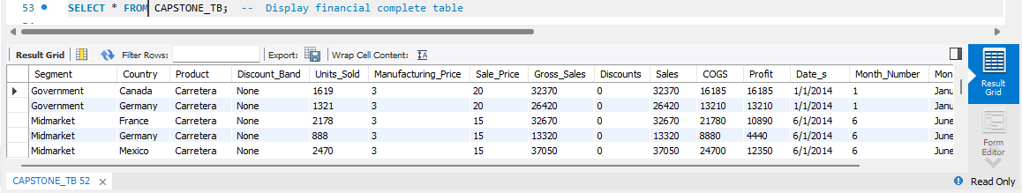
Query - 01
Query - 02

Slide 17
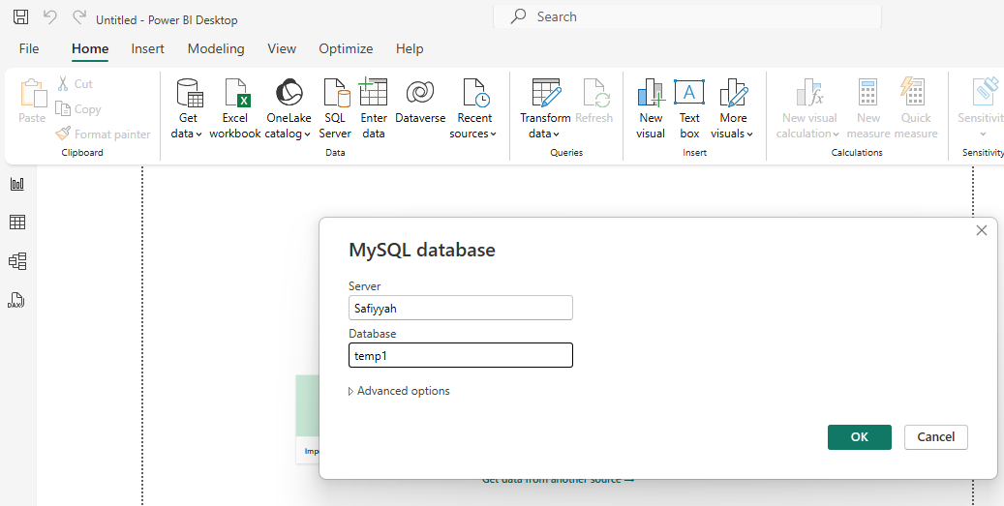
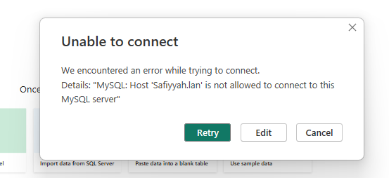
Unable to connect in my system it may some technical issues

Slide 18
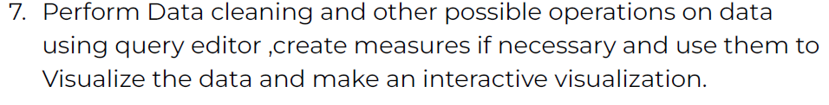
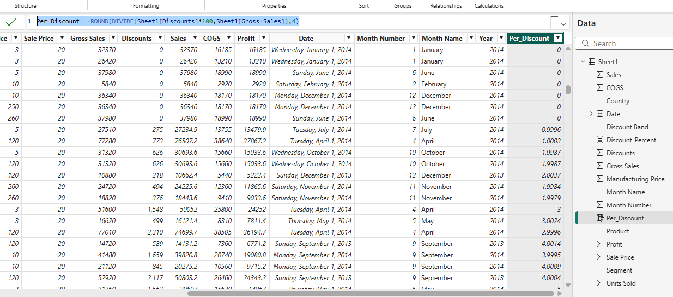
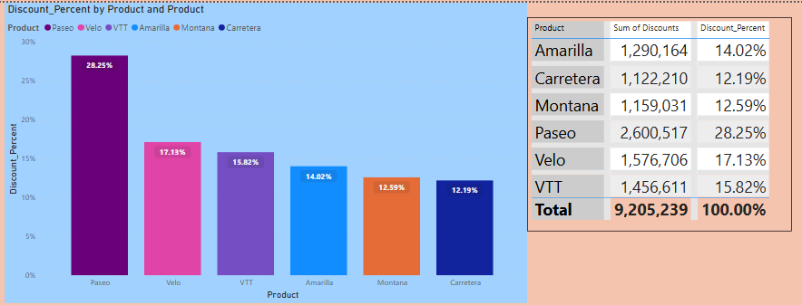

Slide 19
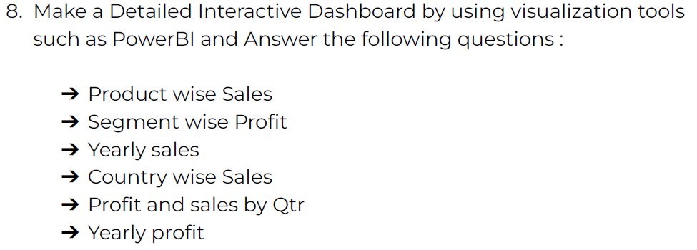
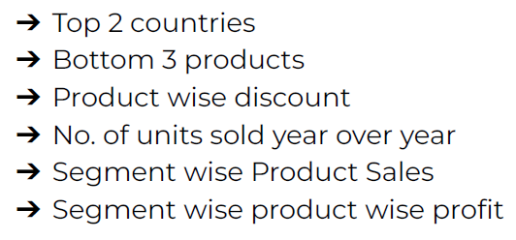
Dashboard created according to question 9 but some of the above chart used there in dashboard.

Slide 20
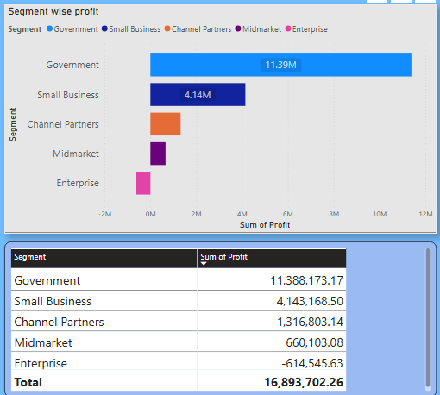
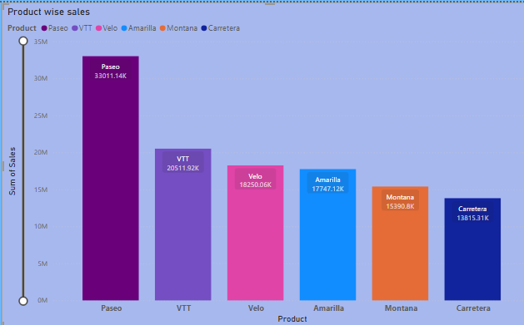
- Product wise sales
- Segment wise profit

Slide 21
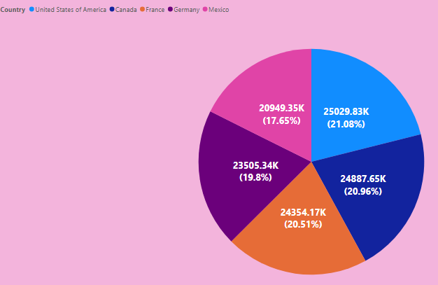
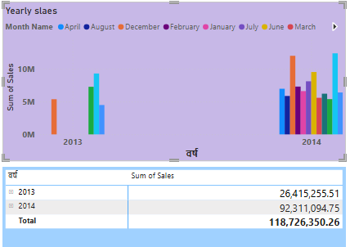
- Yearly sales
- Country wise sales

Slide 22
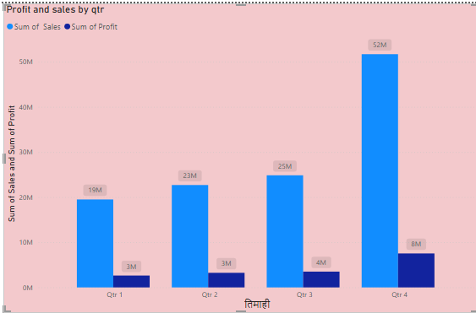
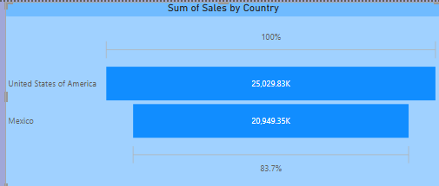
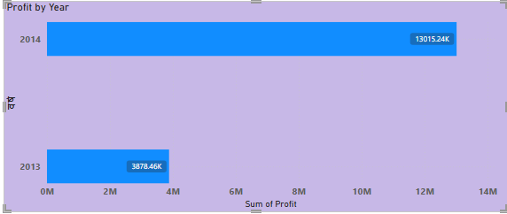
- Profit and sales Quarter
Yearly Profit
Top 2 countries

Slide 23
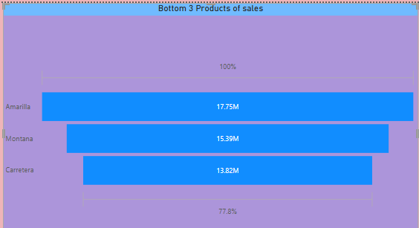
- Bottom 3 Products
- Product wise discount

Slide 24
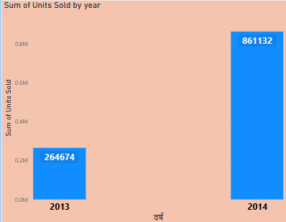
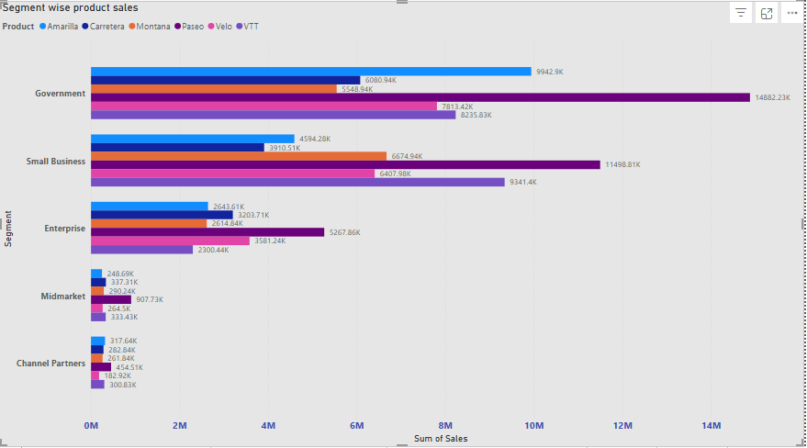
- No. of units sold year over year
- Segment wise Product Sales

Slide 25
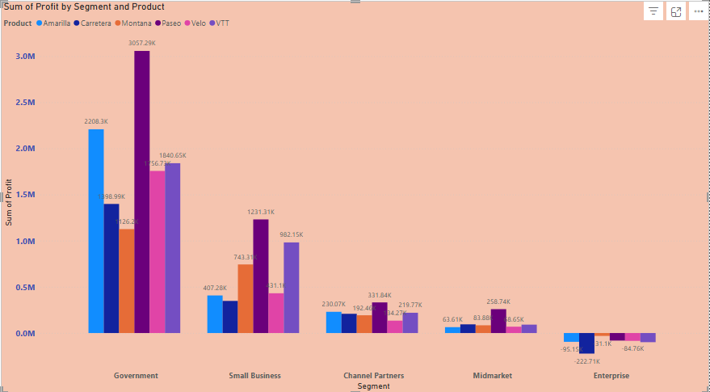
- Segment wise product wise profit

Slide 26
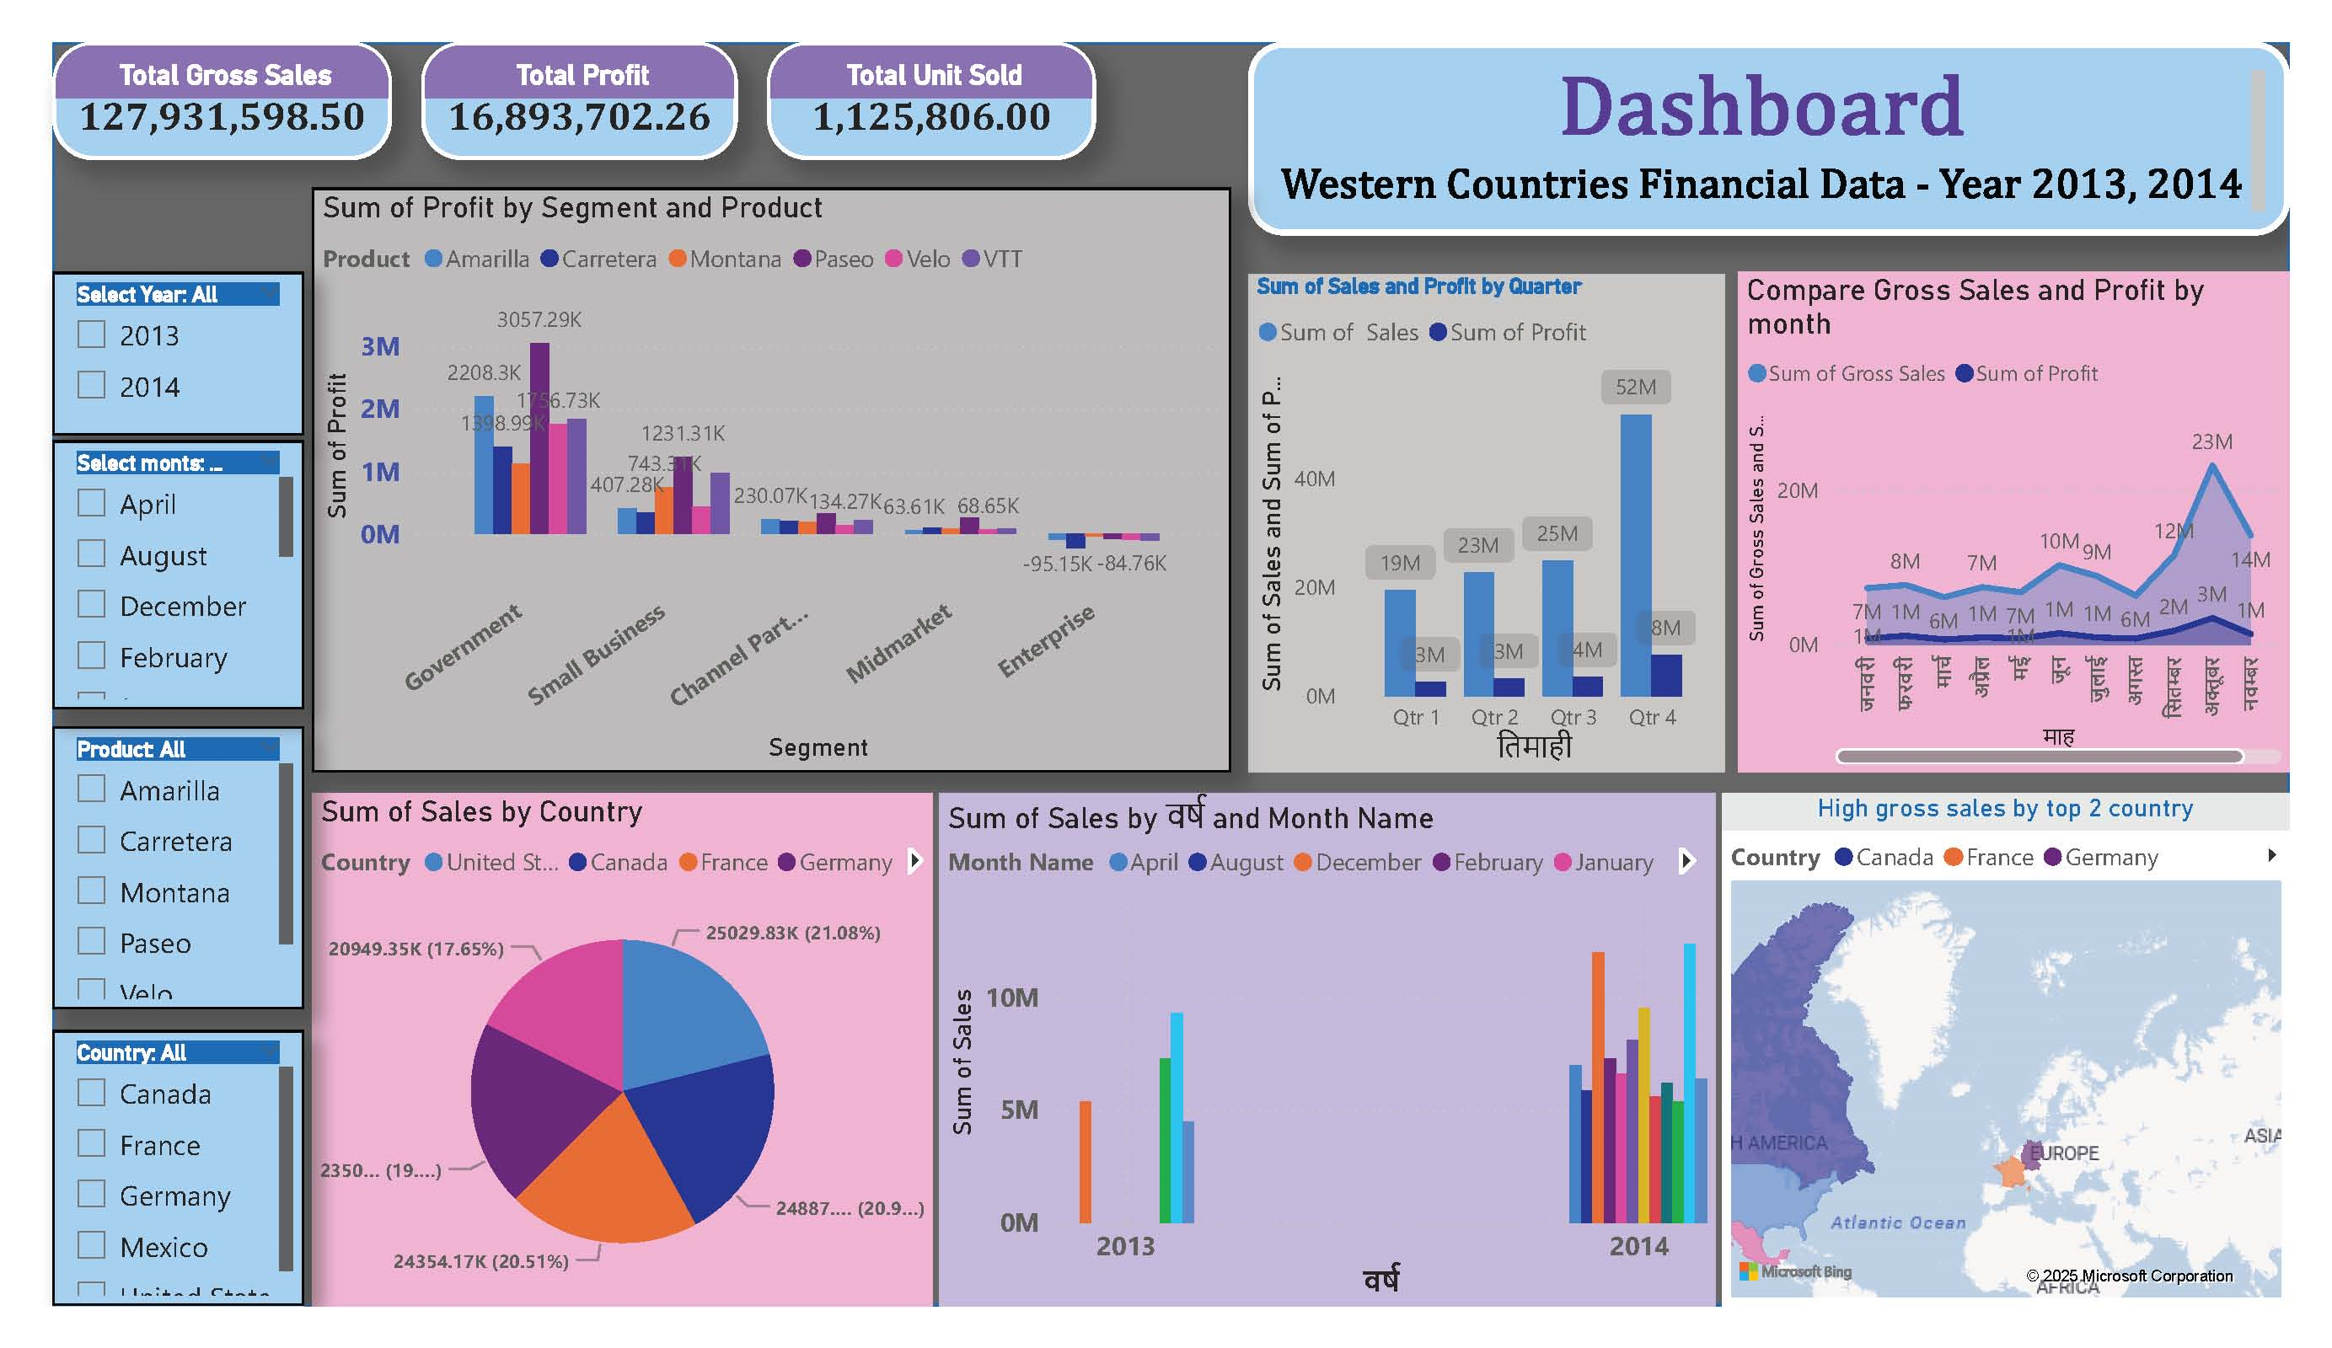

Slide 27
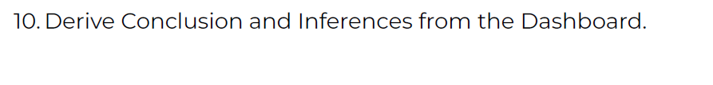
Government segment’s each product sales is the best from other segment but Enterprise segment is losing a lot.
Comparatively 2014 sale 2013 is very low.
Paseo product is very high in demand in every country
U.S.A and Mexico is the top sailing country
Government sector returned good profit.

Slide 28
Summary of copy project
The following soft copy inside the folder
PPT - Presentation of the project
Pdf - PPT file converted in PDF
Excel - Summary of data, dashboard
Sql - imported table into mysql
Pbix - visualization dashboard
Note : All the above file is in the zip folder

Slide 29
Thank you for your time to review

